Slide 1
EZ Stay Hotel
Hotel System
Moriah. Griffin, Jim

Slide 2
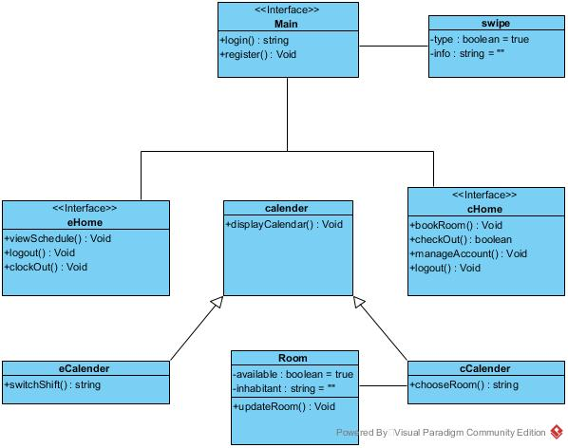
Class Diagram
1 *
1
1
1
1

Slide 3
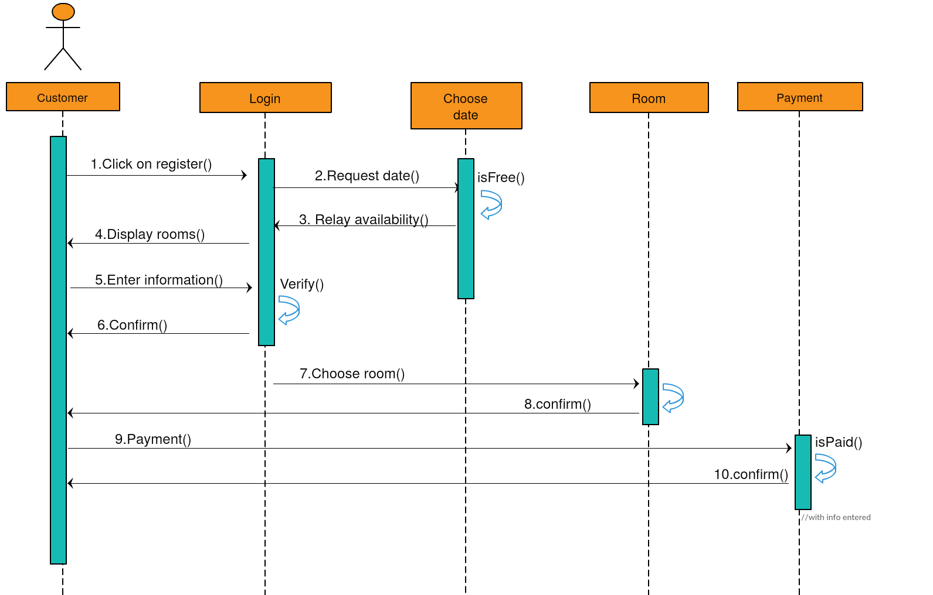
Sequence Diagram [1]
Customer check in

Slide 4
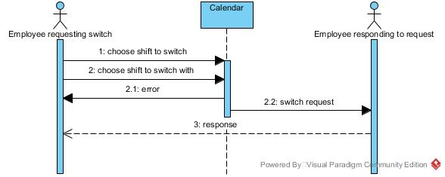
Sequence Diagram [2]
Employee Requesting Switch

